Slide 1




IILM UNIVERSITY
STUDENT CREDENTIALS
GREATER NOIDA, UTTAR PRADESH
Shaily Pathak
Enrollment / Roll No.
Program & Semester
25SCS1003003726
B.Tech (CSE)
AI Deployment and automation
An 8-Week Professional Internship Presentation Report
HOST ORGANIZATION
EduSkills Academy
INTERNSHIP DURATION
Supported by AICTE National Internship Portal
June 2026 – August 2026 (8 Weeks)

Slide 2

Candidate & Program Overview
Candidate Details
Internship Profile
Student Name SHAILY PATHAK
Program Name AICTE – EduSkills Virtual Internship
Roll Number 25SCS1003003726
Specialization Domain AI Deployment & Automation
Degree B.Tech (Computer Science & Engineering)
Duration 8 Weeks (June 2026 – August 2026)
Academic Batch 2026-2027
Certificate ID 2026-E38A24E157
University IILM University, Greater Noida, U.P.
Offer Letter Ref C17Y2026M081511743

Slide 3






Organization Profile: EduSkills Academy
"Nation Building Through Skills"
AICTE Collaboration
Industry Alignment
Core Focus Domains
Operates under the patronage of the AICTE National Internship Portal to empower engineering talent across India.
Partners with leading global tech organizations to bridge academia and industry gaps in emerging tech.
Artificial Intelligence, MLOps, Cloud Computing, Cybersecurity, and Enterprise Automation.

Slide 4


Problem Statement & Industry Context
The Industry Challenge
The Solution Scope
While academic curriculum extensively covers building Machine Learning and Deep Learning models, students often lack hands-on exposure to deploying models into real-world production systems.
This internship addresses the complete end-to-end lifecycle of production AI: model serving, container packaging, cloud hosting, automated scaling, observability, and retraining triggers.
A high-performing ML model in a Jupyter Notebook provides zero business value until it is exposed as a reliable, scalable, monitorable, and secure API service.
Mastering industry-grade tools (FastAPI, Docker, Kubernetes, LangChain, SageMaker) to transform research prototypes into enterprise AI solutions.

Slide 5







Core Project Objectives
API & Containerization
Cloud & Orchestration
Learn advanced model serving with FastAPI (async operations) and build portable, production-ready Docker containers for MLOps.
Deploy AI/GenAI models on Amazon SageMaker, Vertex AI, and Azure ML, and manage multi-container pods using Kubernetes.
Agentic Workflows & RAG
Observability & Drift
Construct intelligent AI agents and business automation pipelines using LangChain, LlamaIndex, LangGraph, and Vector Databases.
Implement continuous monitoring and logging using Prometheus, Grafana, and Evidently AI for automated drift detection.

Slide 6




Technologies & MLOps Toolchain
Serving & Apps
DevOps & Cloud
GenAI & Agents
Monitoring & Drift

Slide 7





Production AI Architecture
Model Layer
Base ML / LLM models providing core intelligence and inference capabilities.
API Layer
FastAPI wrapper delivering high-throughput sync & async inference REST endpoints.
Container & Cloud
Docker packaged containers orchestrated via Kubernetes pods across AWS/Azure/Vertex.
Agent & App Layer
LangChain & LlamaIndex workflows integrated with interactive Streamlit interfaces.
Observability Layer
Real-time tracking and metrics using Prometheus, Grafana, and Evidently AI.

Slide 8
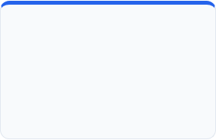

Curriculum Timeline (Weeks 1 to 4)
WEEK 1
WEEK 2
WEEK 3
WEEK 4
AI Deployment & FastAPI
Docker & CI/CD
Cloud AI & GenAI
AI Agents & Automation
AI lifecycle, MLOps terminology, async API endpoints, and production readiness.
Dockerfiles, container volumes, networking, and automated CI/CD for machine learning.
SageMaker, Vertex AI, Azure ML, vLLM serving, and model quantization techniques.
LangChain, LlamaIndex, agent orchestration using LangGraph workflows.

Slide 9
Curriculum Timeline (Weeks 5 to 8)
WEEK 5
WEEK 6
WEEK 7
WEEK 8
Security & App Integration
Kubernetes & Observability
Optimization & Drift
Applied Capstone
Streamlit/Gradio apps, model security, privacy, and bias mitigation strategies.
Container orchestration, Pods, Services, Prometheus, and Grafana logging.
Evidently AI drift detection, auto-retraining, Advanced RAG, and Vector DBs.
End-to-end full-stack RAG app deployment, business automation AI agents.

Slide 10


Key Projects & Demonstrated Skills
Production-Ready API Development
Developed high-throughput RESTful endpoints using FastAPI with async support for AI inference.
Containerization & Orchestration
Package ML models into lightweight Docker containers and orchestrating them via Kubernetes Pods & Services.
Full-Stack RAG Application
Built an end-to-end Retrieval-Augmented Generation application utilizing Vector Databases, FastAPI backend, and Streamlit frontend.
Agentic Workflows for Automation
Designed multi-step AI agents using LangChain and LangGraph for real-world enterprise business automation.
Model Governance & Drift Monitoring
Configured Evidently AI alongside Prometheus and Grafana dashboards to track prediction drift and trigger retraining.

Slide 11
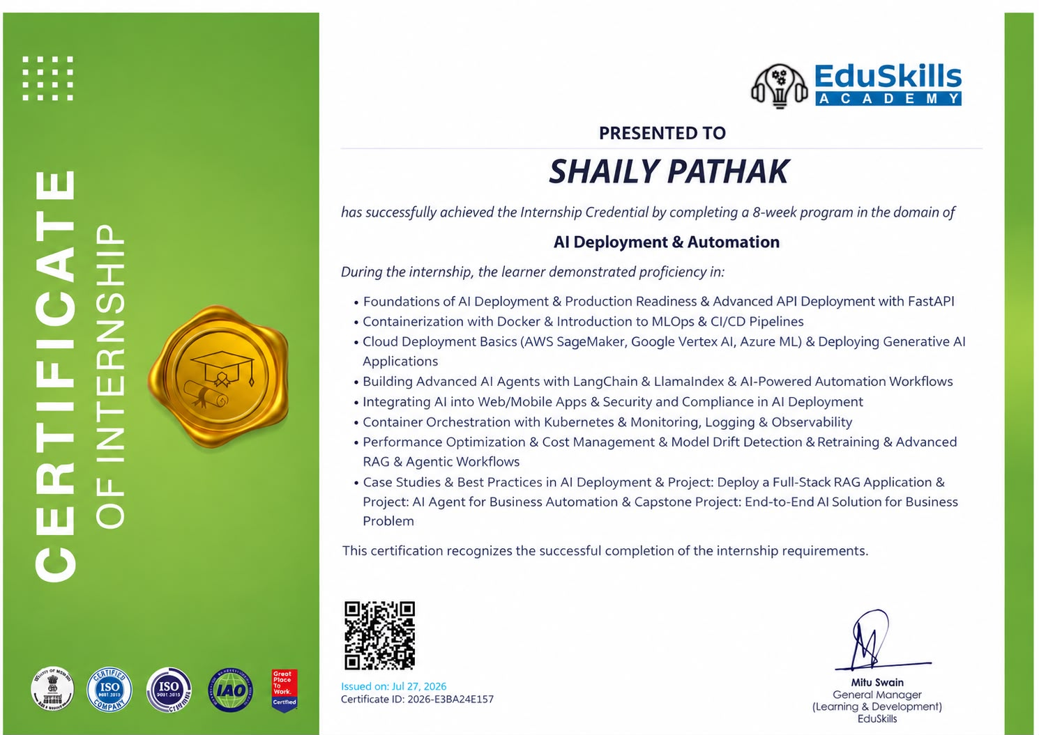

Official Certificate of Internship

Slide 12


Thank You!
Shaily Pathak
Roll No: 25SCS1003003726
School of Computer Science & Engineering
IILM University, Greater Noida, U.P.

